Slide 1
Web Design VS Web Development

Slide 2

Made By
Ahmed Mohamed Abubakr
Electronics engineer IC designer
Full stack web developer
Ambassador at TIEC-IA

Slide 3


Slide 4
THE WEB ?!!
What is websites and why we make it ?
What is the sections inside it ?
How I work ?
What do I need to start ?
Road map to be good developer ?

Slide 5
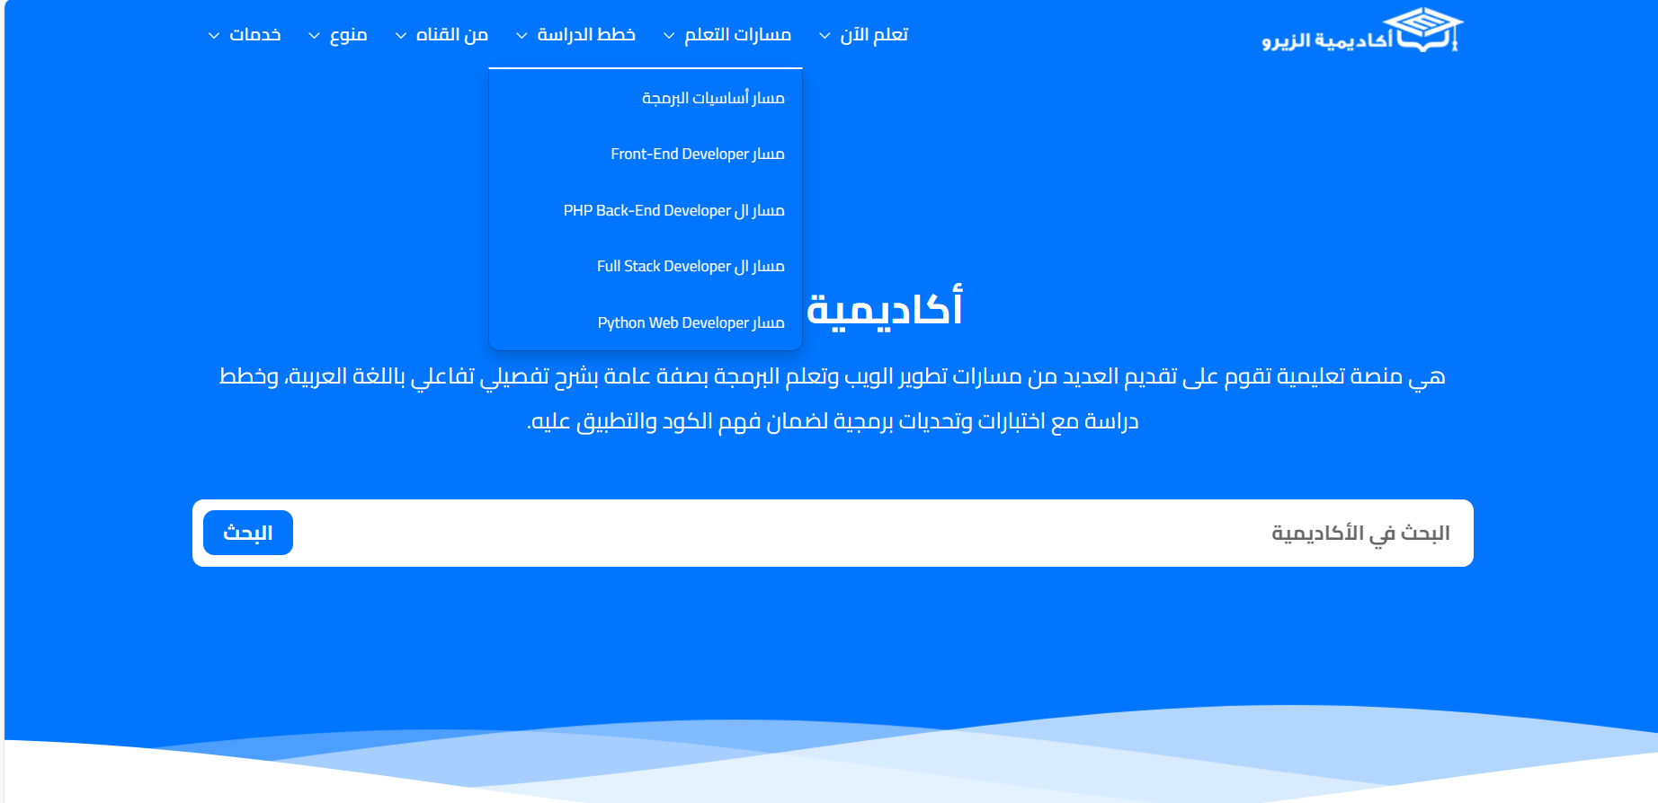
https://elzero.org/

Slide 6
Developers VS Designers
What do we call designers and developers ?
What tools they use ?
Who starts the project ?

Slide 7
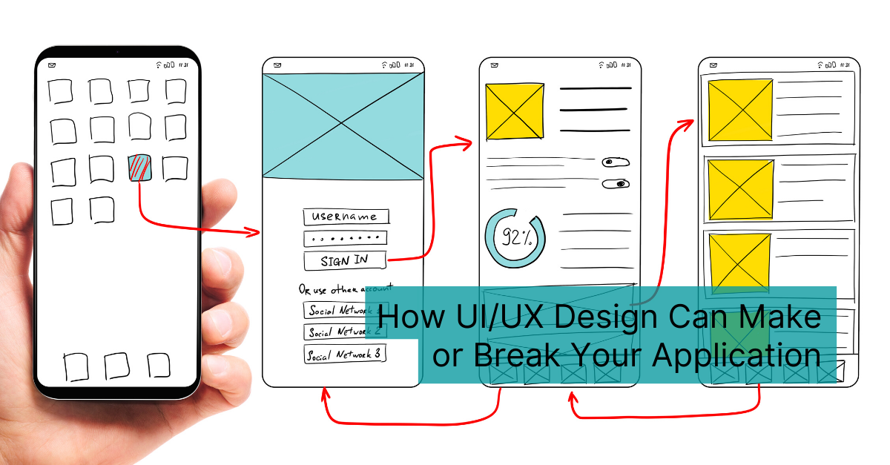

Slide 8
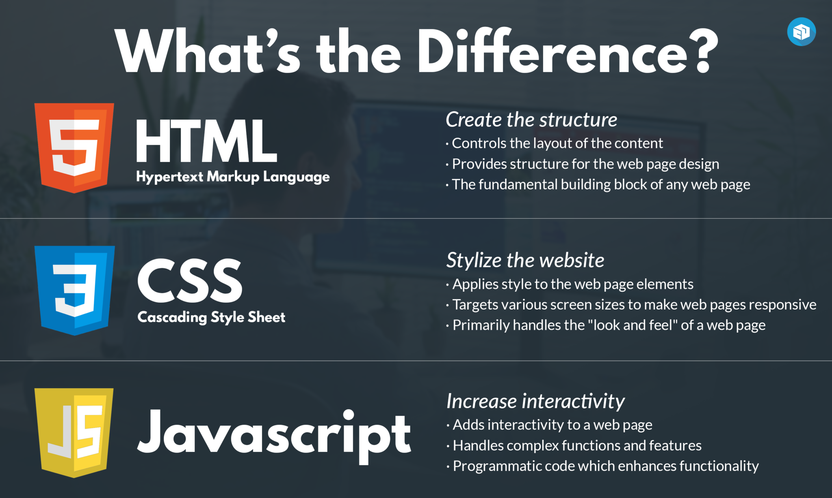

Slide 9
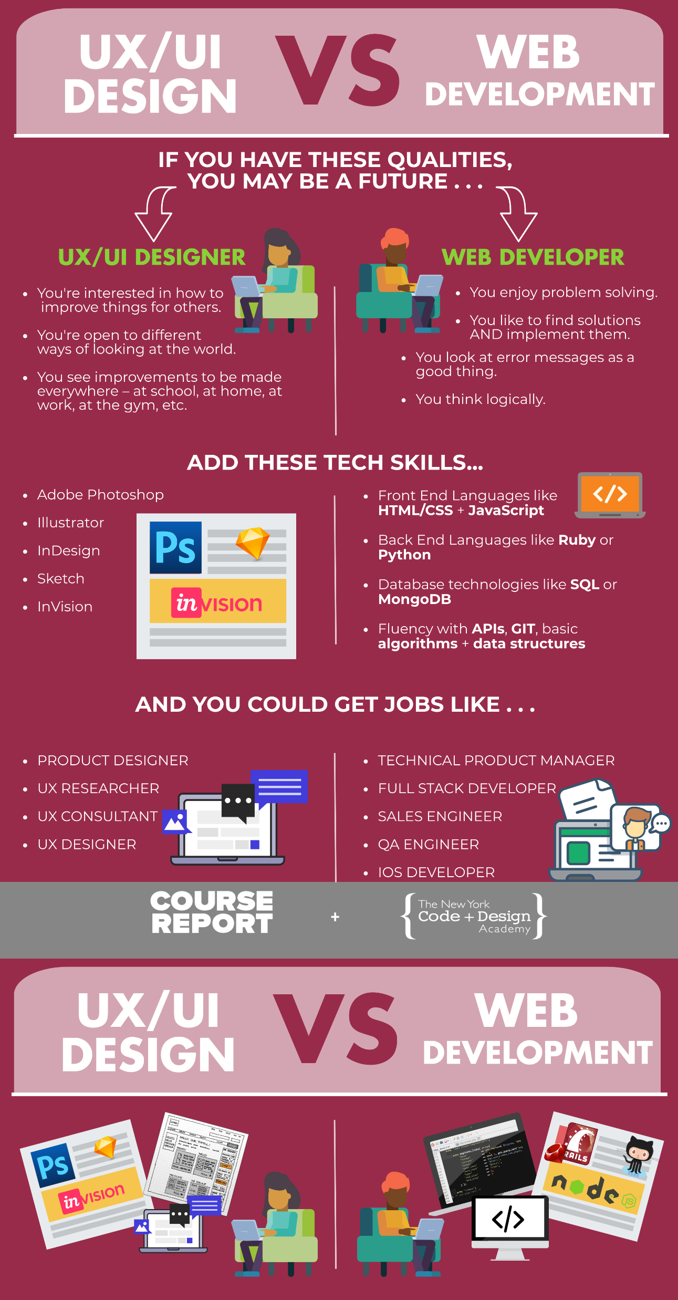

Slide 10
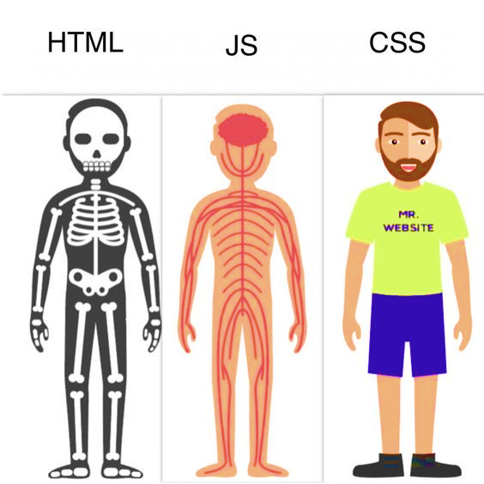

Slide 11
Compiled VS Markup VS script languages

Slide 12
Mark-up language
Descriptions of how text and other forms of components should appear in a certain context (i.e. HTML, hypertext mark-up language - is the instructions for the context of a web page).
Mark up languages tend to provide structure to data and/or determine how it is displayed.
• HTML- hypertext mark-up language
• Dynamic HTML
• XML-extensible mark-up language
• XHTML- extensible hypertext mark-up language
• CSS

Slide 13
Compiled language
A programming language is a language used by humans to give instructions to a machine.
The other main type is compiled programming languages. C, C++, Objective-C, Swift. These take text files, run them through a compiler, and the compiler creates binary instruction files (binaries). These are the lower level languages, they "talk to" the memory and processor.
Programming languages (almost always) need to be compiled before running and instruct the computer to perform tasks/calculations, including how to perform them (although if you're using a high-level language the low level instructions are hidden in the syntax).
• JAVA, C++, COBOL, C++ and VB, C#, etc.

Slide 14
Scripting language
Usually use an interpreter or some running application to take programming commands and turn them into instructions to be executed. Scripting languages are programming languages, but they fit into a category called interpreted languages (i.e. Python, Ruby and PHP). We can write full featured applications with scripting languages.
A scripting language is a subset of programming language that is used to produce scripts, which are sets of instructions that automate tasks that would otherwise be performed manually by a human. Of course, these "tasks" are essentially a human giving instructions to a machine.

Slide 15
Difference between Programming Language and Mark-up Language
Sometimes the terms programming language and scripting language are used colloquially to describe compiled programming languages and interpreted programming languages, respectively. Compiled programming languages are languages whose instructions are translated (compiled) directly into machine code, whereas interpreted languages are those that require a program known as an interpreter, which interprets instructions in terms of previously compiled machine code.
Mark up languages annotate the content of a document with information on the document's structure or presentation. More recently, the task of annotating documents with information about their presentation has been delegated to style sheet languages, such as Cascading Style Sheets (CSS). Both are related to historical, physical mark up and style sheets as seen in publishing and other fields.

Slide 16
HTML (Hyper Text Markup Language)
Meaning of HTML
What can it do
Syntax
Tags
Sourcing files
Files HTML deal with
Opening the code

Slide 17
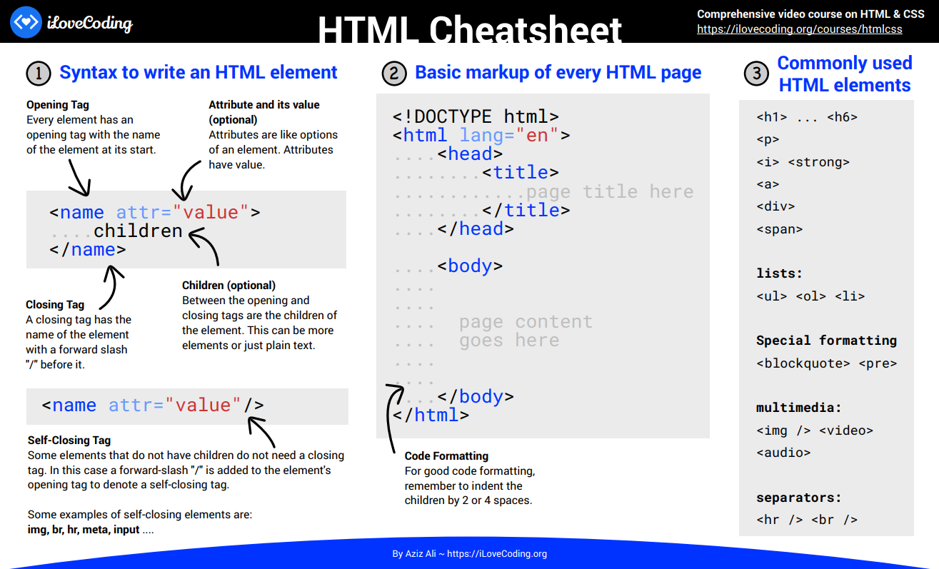

Slide 18
Lets have example
<!DOCTYPE html>
<html>
<head>
<title>Hi-from-title</title>
</head>
<body>
<h1>This is a page</h1>
<p>a very simple page</p>
</body>
</html>

Slide 19
CSS (Cascading Style Sheet)
Meaning of CSS
What can it do
Syntax
Where can I write the code
Accessing the tag
Animations
Notes:
(for example hover)

Slide 20
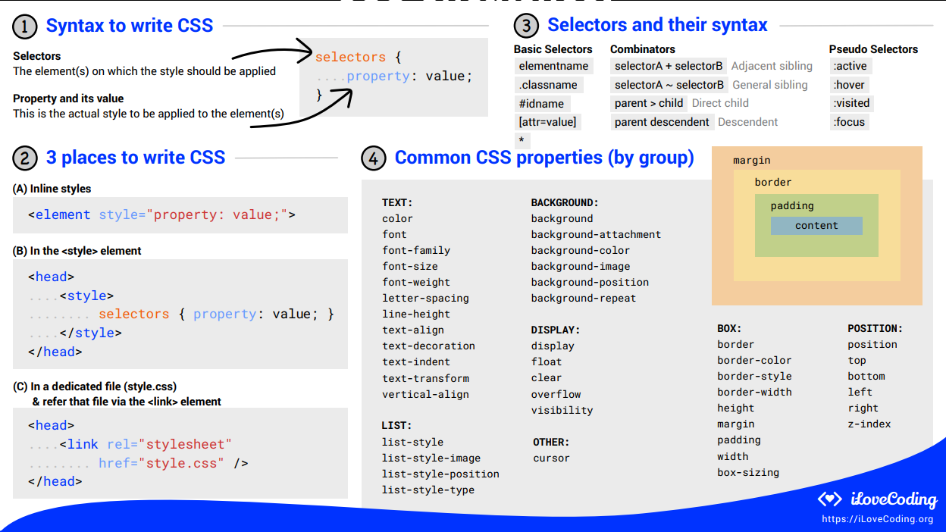

Slide 21
Style the page
<style>
h1 {
color: red;
}
</style>

Slide 22
Lets talk about javaScript
Syntax
Variables / Constants & datatypes
Conditional Statements
Loops
Arrays
Functions

Slide 23
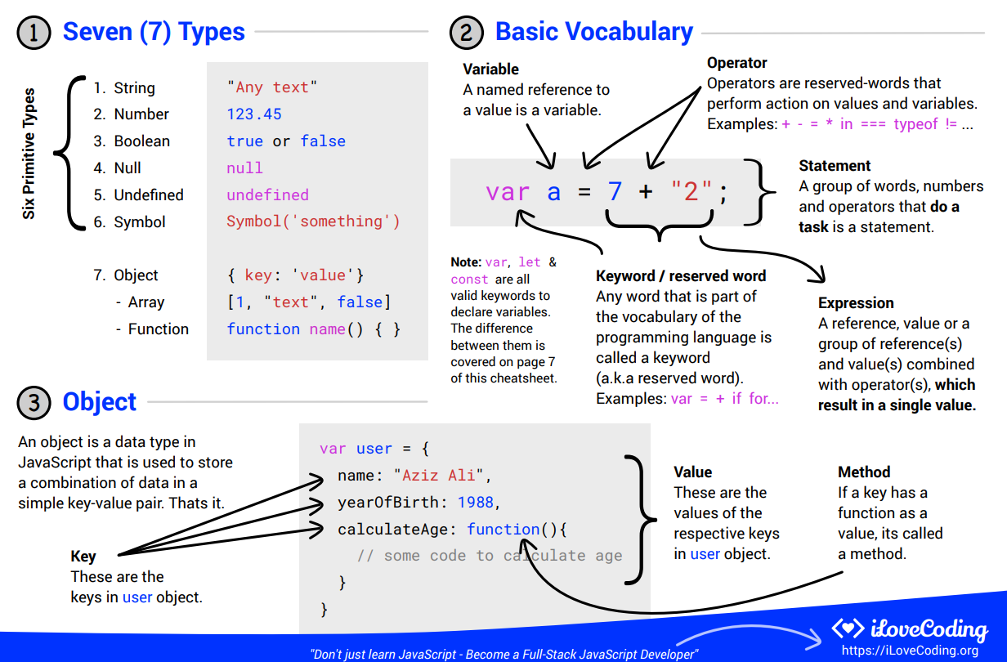

Slide 24
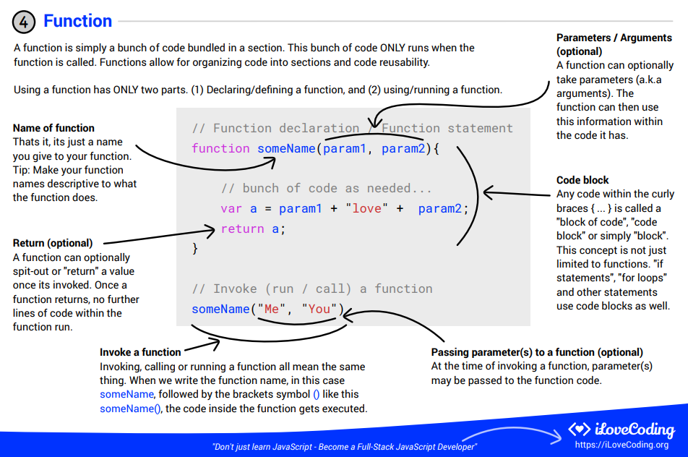

Slide 25
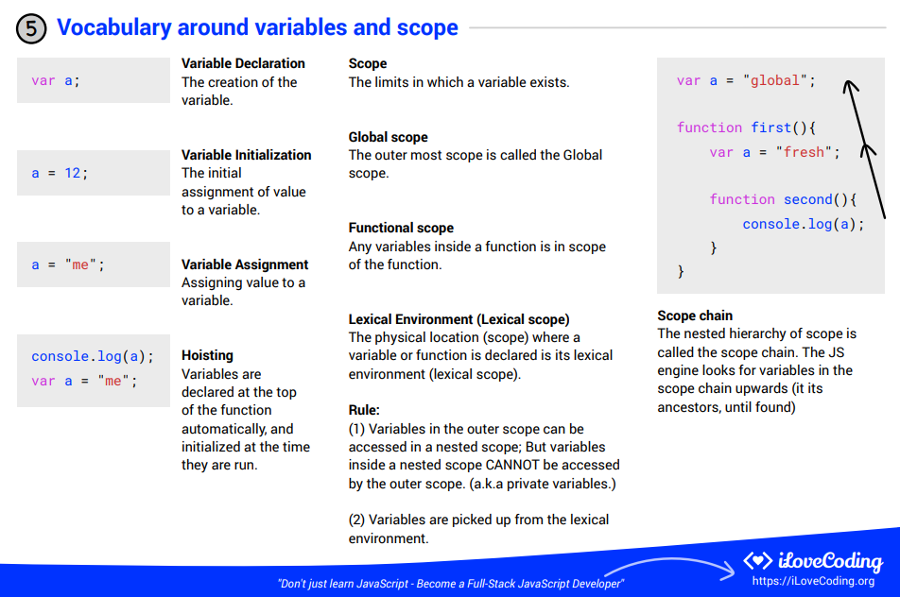

Slide 26
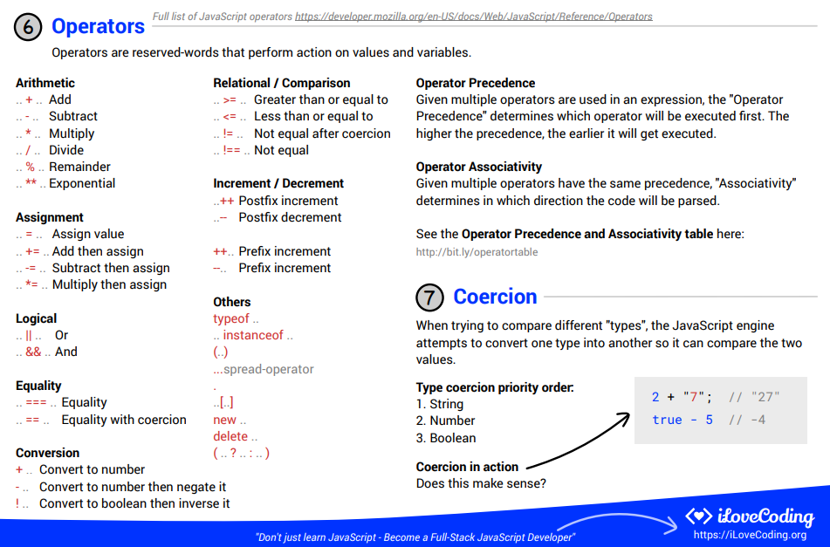

Slide 27
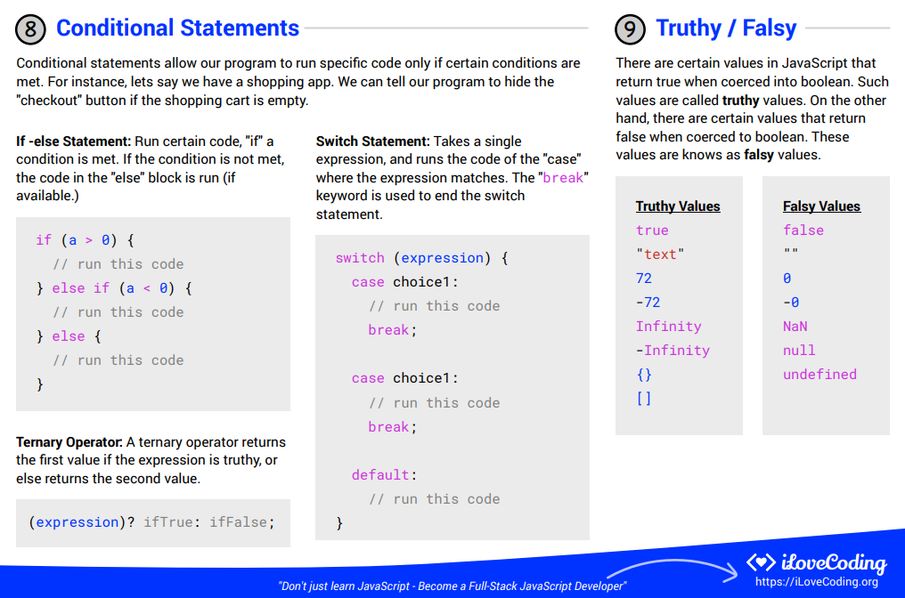

Slide 28
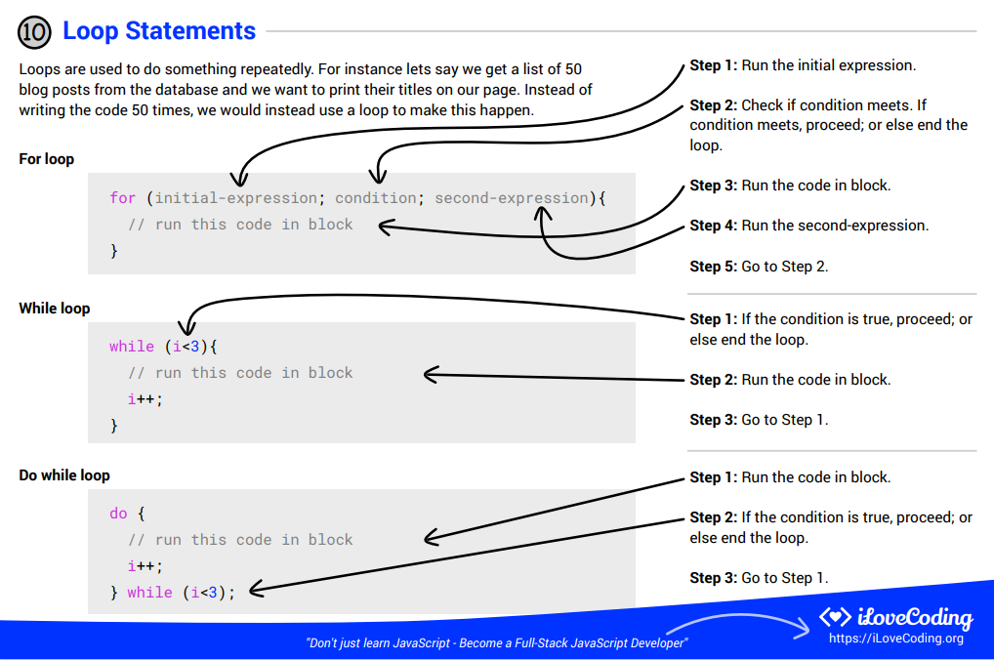

Slide 29
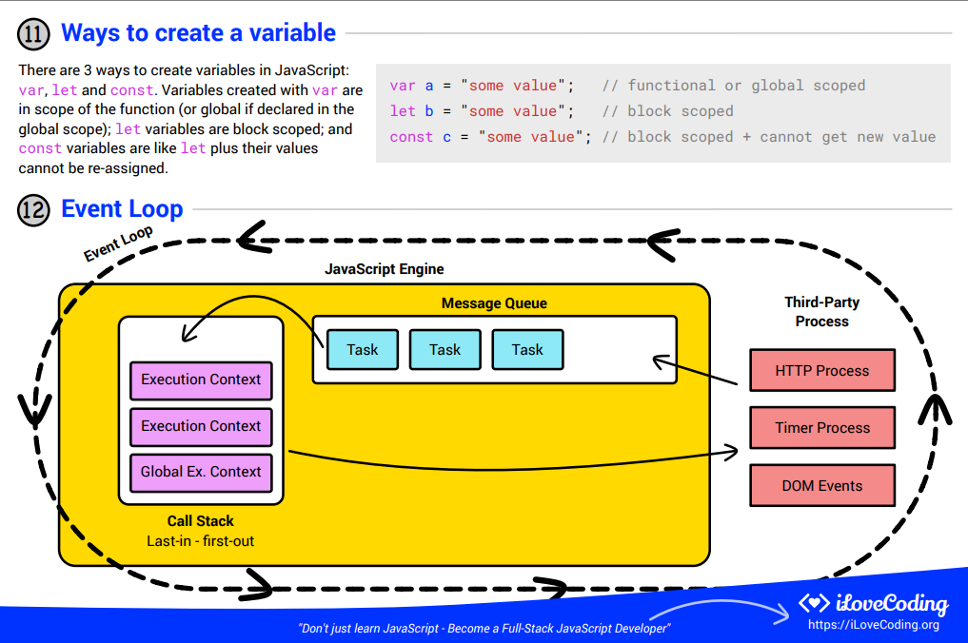

Slide 30
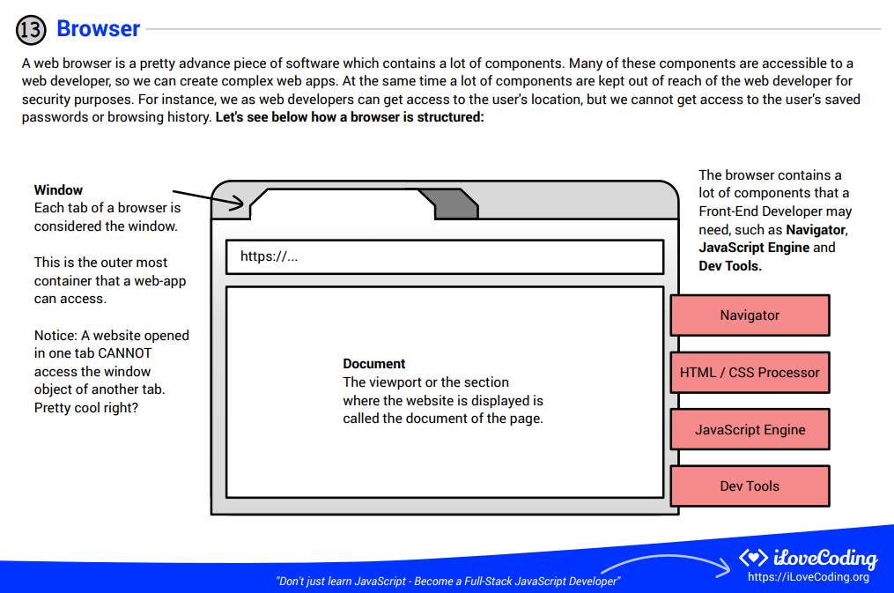

Slide 31
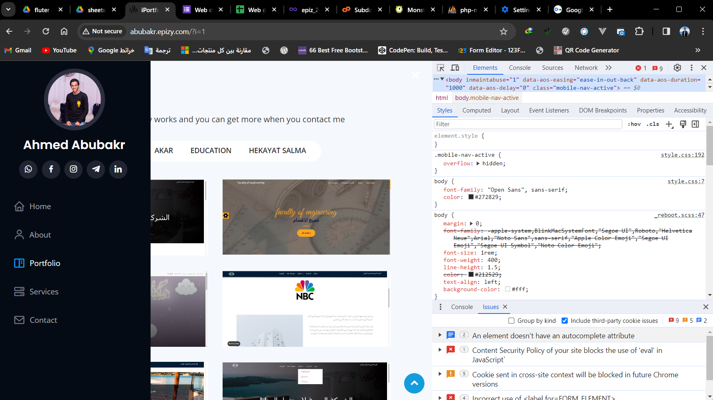

Slide 32
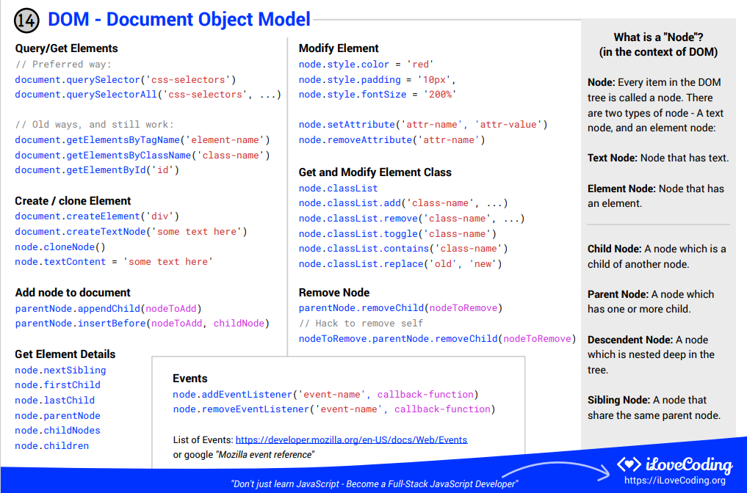

Slide 33
Script it
<script>
document.write("hi");
</script>

Slide 34



Example
Lets be web developers and create a website

Slide 35
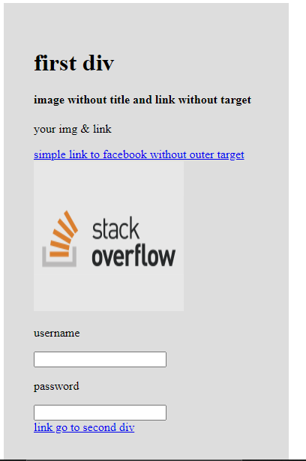
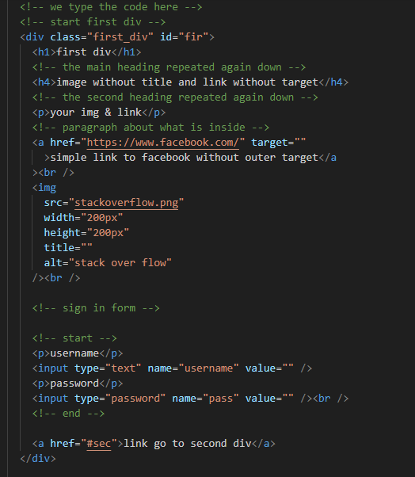
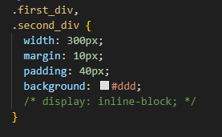

Slide 36
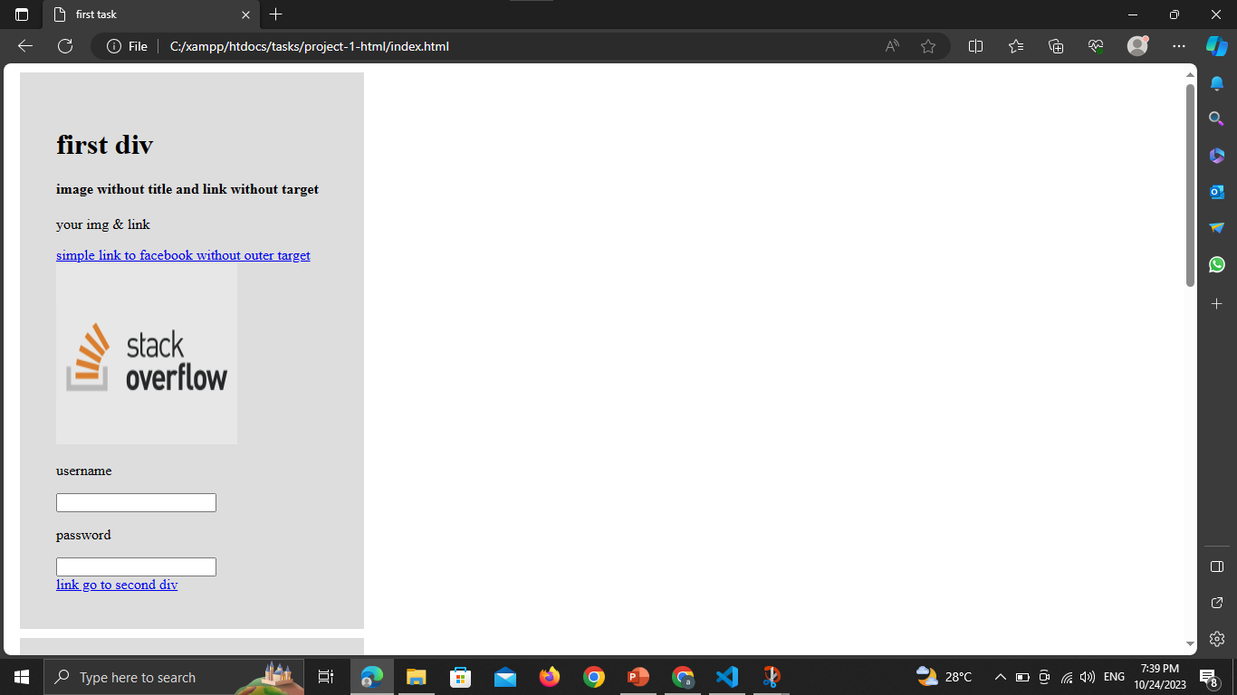

Slide 37
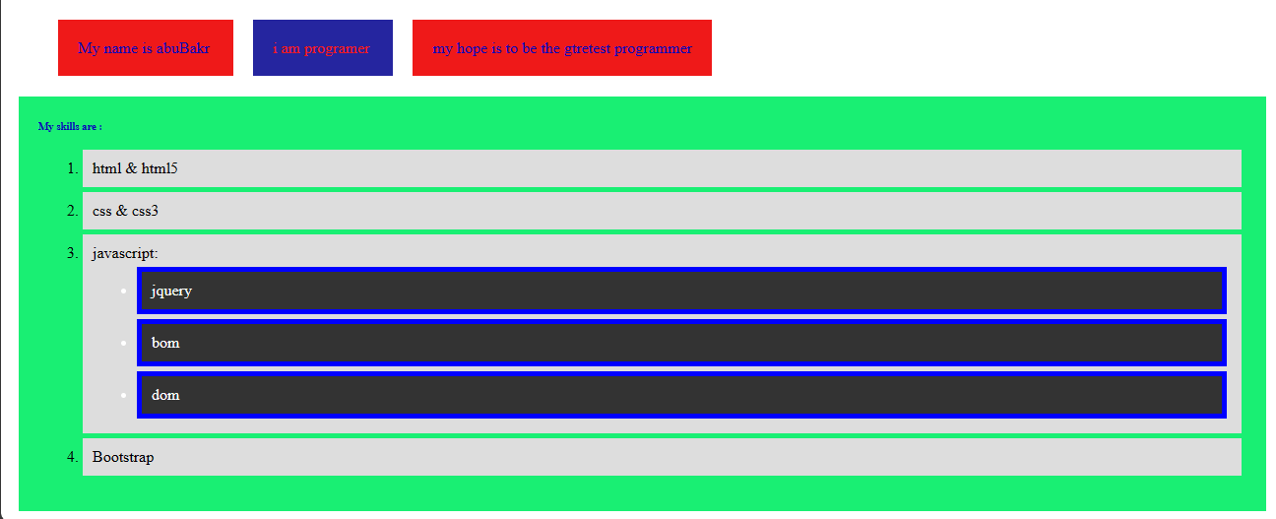
First Task

Slide 38
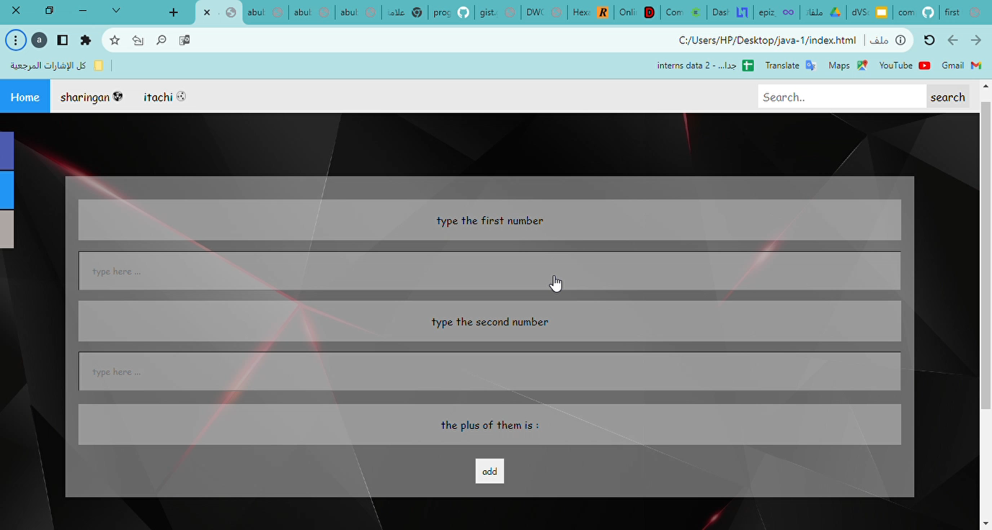
Third Task

Slide 39
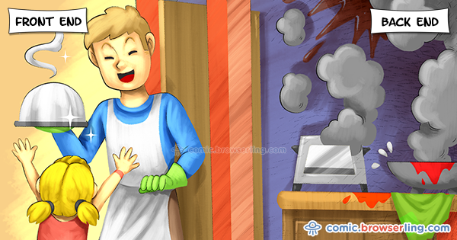

Slide 40


The End
in the end I hope you understood all I said contact on :
https://www.facebook.com/abobakr143
https://wa.me/201113284597

